Slide 1

Real Time Analysis Of Bank Customer
Name:- Laxman Gangadhar Chincholakar
AICTE ID: STU6661a1ceba02f1717674446

Slide 2

PROBLEM STATEMENT
Analyzing Bank Customer Data to Enhance Customer Segmentation and Financial Services

Slide 3
In today's competitive banking environment, understanding customer demographics and their financial behaviors is crucial for delivering personalized services, improving customer satisfaction, and optimizing marketing strategies. However, banks often face challenges in effectively analyzing and interpreting vast amounts of customer data. This project aims to address these challenges by developing a comprehensive Power BI dashboard to analyze key aspects of a bank's customer base.

Slide 4

WHO ARE THE END USERS?
The end users of this Power BI dashboard are:
Bank Executives: To make strategic decisions based on customer demographics and financial behavior insights.
Marketing Teams: To design targeted marketing campaigns and improve customer acquisition strategies.
Customer Relationship Managers: To provide personalized services and enhance customer satisfaction.
Financial Analysts: To analyze customer data trends and patterns for better financial planning and forecasting.

Slide 5

Technology Used
Power BI: For data visualization and dashboard creation.
Data Sources: The bank's customer data, including demographics, account balances, Date Joined etc.
ETL Processes: To extract, transform, and load data into Power BI for analysis.

Slide 6
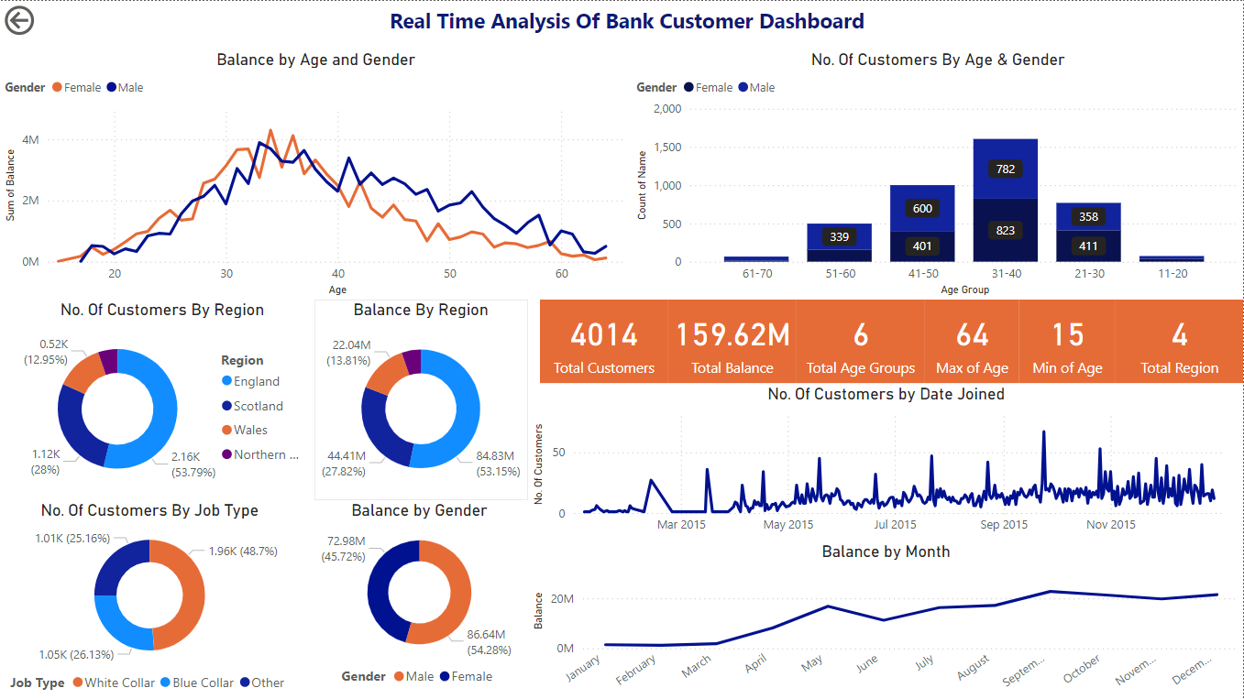
RESULTS
GitHub Link: https://github.com/Laxman-Chincholakar/VOIS---Connecting-Dream-Foundation-Internship-Power-BI-Project

Slide 7
Thank you
.
.

